Slide 1
Workforce Development
What the heck is it and why should you care?
May 29, 2024

Slide 2
What does Workforce Development Mean to You?
Menti.com access code is 6857 3699

Slide 3
Welcome!

Slide 4
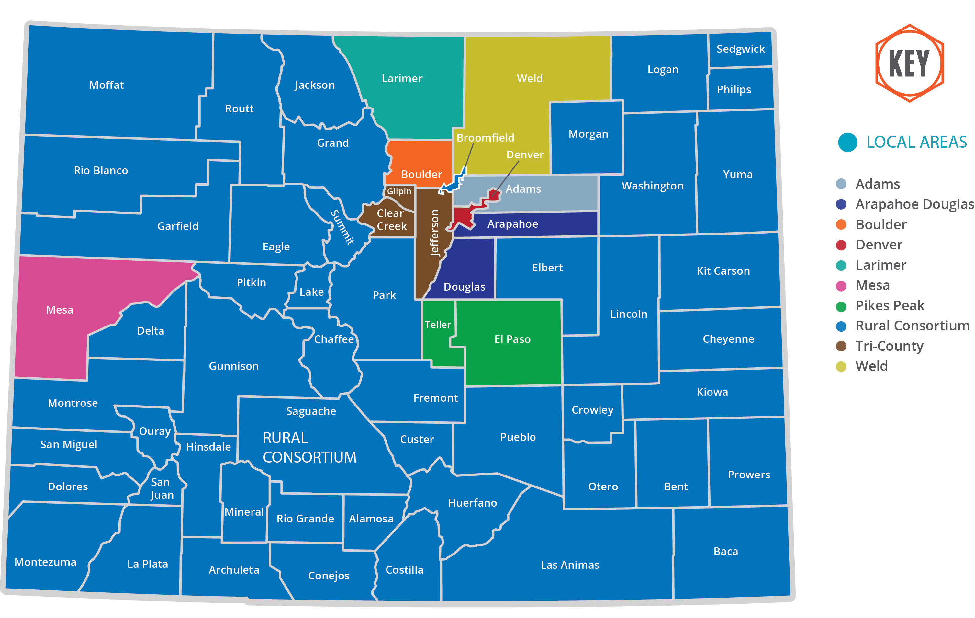
Workforce Development Fundamentals
Statewide system comprised of 10 local workforce areas
Funding streams
Workforce Innovation and Opportunity Act (WIOA) formula funds, supplemented with discretionary federal and state funds

Slide 5
Business Engagement

Slide 6
Business Engagement

Slide 7
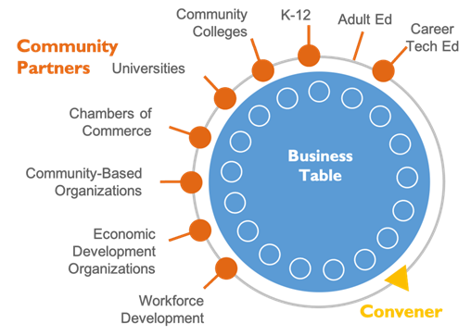
Sector Partnerships
Sector partnerships are partnerships of business leaders, from the same industry and in a shared labor market region, who work with education, workforce development, economic development, and community organizations to address the workforce and other competitiveness needs of their industry
Colorado Sector Partnerships Include:
Manufacturing
Healthcare
Hospitality
Construction
Tech Talent
Aerospace
Freight Industry
Early Childhood Education
Tree Care
Retail

Slide 8
Success Through Collaboration
Dr. Mordecai Brownlee, Power of Sector Partnerships

Slide 9
The Power of Collaborative Partnerships
Economic Development
Chambers of Commerce
Small Business Development Centers
K-12 & Post-Secondary
Community-Based Organizations & Nonprofits
Veterans Services Organizations
Unemployment Insurance
Office of New Americans
Division of Vocational Rehabilitation
Justice-Involved Entities

Slide 10
An Economic Development Perspective
Curtis Englehart, Power of Partnerships

Slide 11
Job Seeker Support
Individualized, Customized Approach
Skills Training and Credentials
Career Counseling and Support
Addressing Skill Gaps
Support for Diverse Populations
Long-Term Career Growth
Economic Prosperity

Slide 12
Evolving Labor Market and Economy
By 2028 Colorado is expected to grow 5.2%, adding nearly 161,302 jobs
Different regions face unique challenges and opportunities :
The Professional, Scientific and Technical sector is expected to grow 10.4%, adding over 31,000 jobs.
Healthcare is expected to grow 6.5%, adding over 21,000 jobs.
Government at all levels is expected to grow 5.4%, adding nearly 30,000 jobs.
Infrastructure jobs will be added in engineering services, research and development, construction and production.
Broadband upgrades.
Green commercial and residential buildings.
Upgrading roads and adding EV plug-in and hydrogen fueling stations.
Electric power generation and storage.

Slide 13
Evolving Dynamics
The Evolving Dynamic of Business and Labor Market Needs
Implications for Businesses
Upskilling and training
Strategic partnerships
Skills-based hiring
Labor and housing shortages
Adoption of digital tools
Implications for Workers
Job stability and retention
Need for continuous learning
Job quality
Adaptable and prepared for possible changes in job availability and market conditions

Slide 14
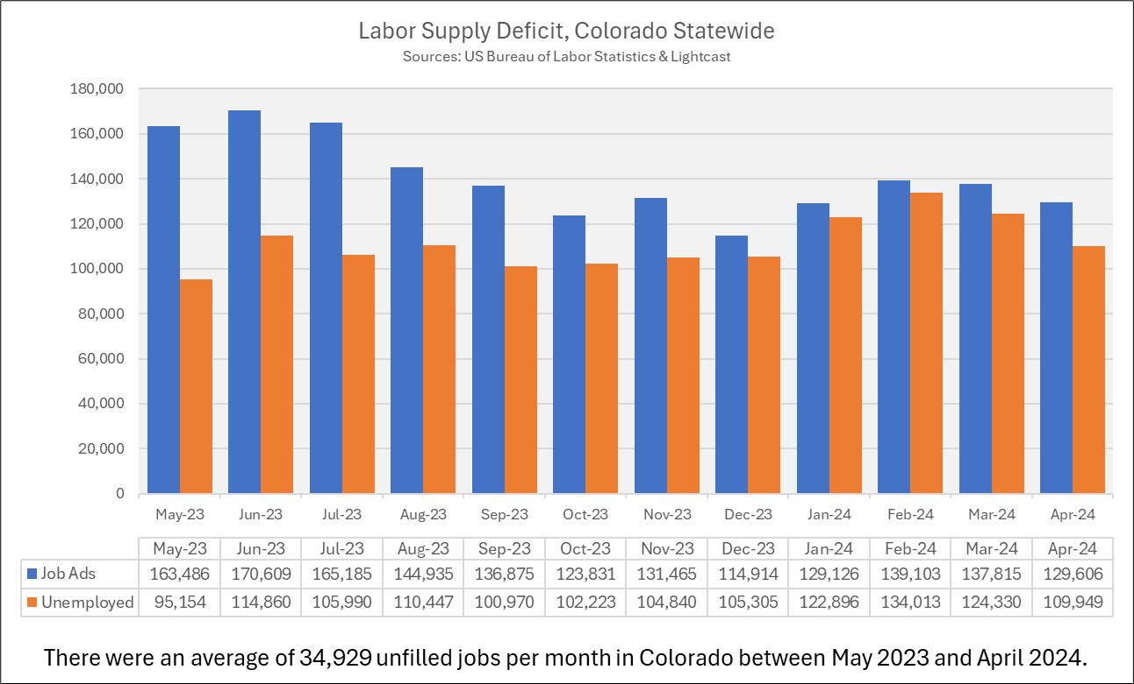
Colorado's Unprecedented Labor Shortage
There are two jobs available for each unemployed Coloradoan
State and national populations are declining
CO LFPR is the 4th highest nationally

Slide 15
Business Insights
Peter Hancock, The Business Perspective

Slide 16
Why Workforce Development Matters
Benefits of Investing in the Workforce Development System
Economic Growth: A skilled workforce attracts businesses and fosters economic development, leading to job creation and higher economic activity in the community
Reduced Unemployment: Workforce development programs help reduce unemployment by equipping individuals with the skills needed to find and retain employment, thereby improving overall economic stability,
Enhanced Quality of Life: As individuals gain employment and higher wages through workforce development, their quality of life improves, which can lead to better health outcomes and stronger community cohesion
Social Equity: Investing in workforce development can help bridge gaps in education and employment opportunities, promoting social equity and reducing disparities in the labor market

Slide 17
The Economic Impact of the Colorado Workforce Development System
The Colorado Workforce Development System has generated an economic impact of $334.7 million dollars in one year
This translates to $9.50 invested in our local economy for every $1.00 federal grant dollar spent
Participants who engaged in the Colorado Workforce Development System earned $12,860 annually more than those who did not engage with our system

Slide 18
Policy Shaping the Workforce Landscape
Federal and State Workforce Legislation
WIOA Reauthorization
The proposed 50% Training Expenditure Mandate for Adult and Dislocated Worker Funds
Increase in the Governor’s Reserve for a ‘Critical Industries Fund’
3. Redesignation Language
State Legislation
HB24-1364
SB24-050

Slide 19
Advocacy
Become a Powerful Advocate
Foster a coalition of Commissioners who are committed to advancing workforce initiatives through CCI
Connect with your local Workforce Director and Workforce Development Boards
Stay informed on state and federal workforce legislation
Advocate through your local delegation
Refer businesses, community partners, and jobseekers to your local workforce center

Slide 20
Engage and Make an Impact
Upcoming Events and Initiatives:
National Association of Workforce Boards (NAWB) Conference
Annually in March
RMWDA Conference, in Partnership with Economic Development
October 13-16, 2024, Park Hyatt, Bever Creek
Workforce Wednesday
Actively engage with your local Workforce Development Board

Slide 21
Questions?

Slide 22
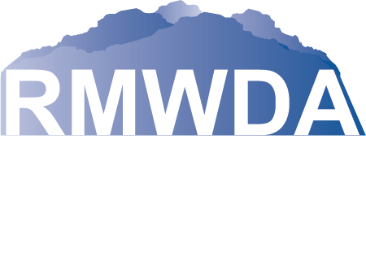
THANK YOU!
Tami Grant President, Rocky Mountain Workforce Development Assoc.
Deputy Director, Weld County Human Services
tgrant@weld.gov
Sasha Easton Director, Arapahoe/Douglas Works!
seaston@arapahoegov.com
Suzie Miller Director, Colorado Rural Workforce Consortium
suzie.miller@state.co.us

