Slide 1
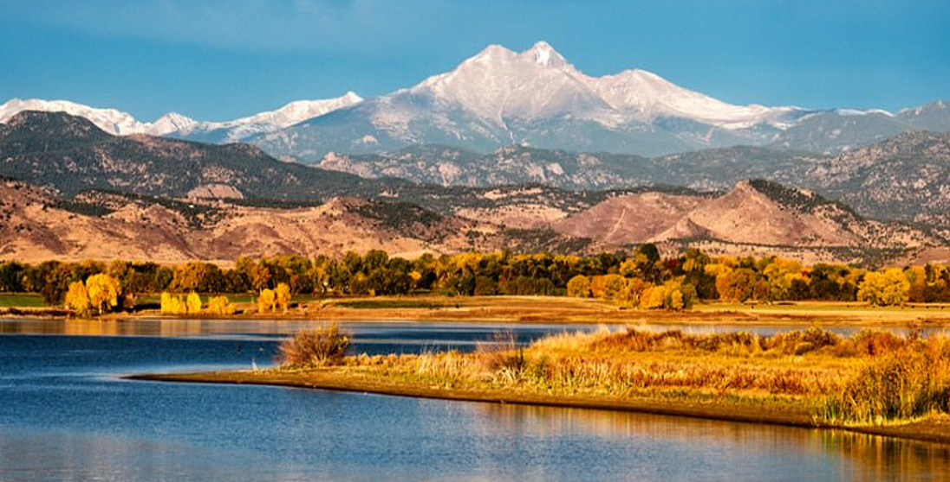
C.A.R.E.S. Funding Allocation Plans in Three Metro Area Cities
Westminster
Arvada
Aurora

Slide 2
CARES/CRF Funds – Appropriation $9 million
Ordinance authorizes the following guidelines and estimates of expenses for each area:
Economic Recovery: Aid in the recovery of our local economy by providing businesses with grants and other support. ($4,000,000)
Social Recovery: Aid in recovery of the quality of life in Westminster by providing programs that rebuild community connections and promote wellness. ($728,448)
People and Programs Serving People: Provide and help partners supply housing and food security to vulnerable and impacted populations. ($750,000)
Local Government Recovery: Help City employees and visitors respond to changing work environments in an innovative way that ensures the health and safety of all. ($3,500,000)

Slide 3
Potential Uses for Funds by Focus Area $9 million
Economic Recovery ($4,000,000):
Reimbursement of WestyRISE Small Business Grant Program ($1.5M)
Additional business assistance such as facility modification
PPE for businesses to give to customers
Social Recovery ($728,448):
Mobile library and computer kiosks
Self-serve recreation
People and Programs Serving People ($750,000):
Housing assistance and food security
PPE for public
Local Government Recovery ($3,500,000):
Hazard pay and salaries for public safety employees
Facility modifications and PPE for employees
Telecommuting solutions

Slide 4
Where we are today $9.45M
SUPPORT FOR BUSINESS | $5,717,000
Small business loans/grants | $2,500,000
Business incentive program | $2,000,000
Olde Town/BID support | $175,000
PPE/Safety | $622,000
Chamber/Visitors Center programs | $420,000
SUPPORT FOR RESIDENTS | $1,056,000
Renter and mortgage relief | $725,000
Shelter | $31,000
Additional support for navigator | $50,000
Homeless family support | $250,000
SUPPORT FOR NON-PROFITS | $1,270,500
APEX | $431,000
Highland Hills | $234,000
Foothills Animal Shelter | $100,000
AFPD | $50,000
Community First Foundation | $250,000
Arvada Center | $205,500
SUPPORT FOR INTERNAL CITY | $1,026,163
PPE, safety, cleaning, temperature | $556,869
Technology | $360,544
Unemployment, sick, EFMLA | $108,750
RESERVED FOR FUTURE | $385,083

