Slide 1
Adams County COVID-19 Response and Recovery
CCI Webinar | April 9, 2020

Slide 2
Impact of COVID-19 on Adams County Health
Adams County (CDPHE 4/7/20 at 4:00 p.m.)
388 cases
14 deaths
Colorado (CDPHE 4/8/20 at 4:00 p.m.)
5,655 cases*
1,162 hospitalized
54 counties
29,199 people tested**
193 deaths
44 outbreaks at residential and non-hospital health care facilities
National (CDC 4/8/20 at noon)
Total cases: 395,011
Total deaths: 12,754
Jurisdictions reporting cases: 55

Slide 3
Adams County COVID-19 Economic Impact Survey Update
Bo Martinez, President/CEO, Adams County Economic Development
Notes:
Becky

Slide 4
Adams County COVID-19 Economic Impact Survey Update
Bo Martinez, President/CEO, Adams County Economic Development
Notes:
Becky

Slide 5
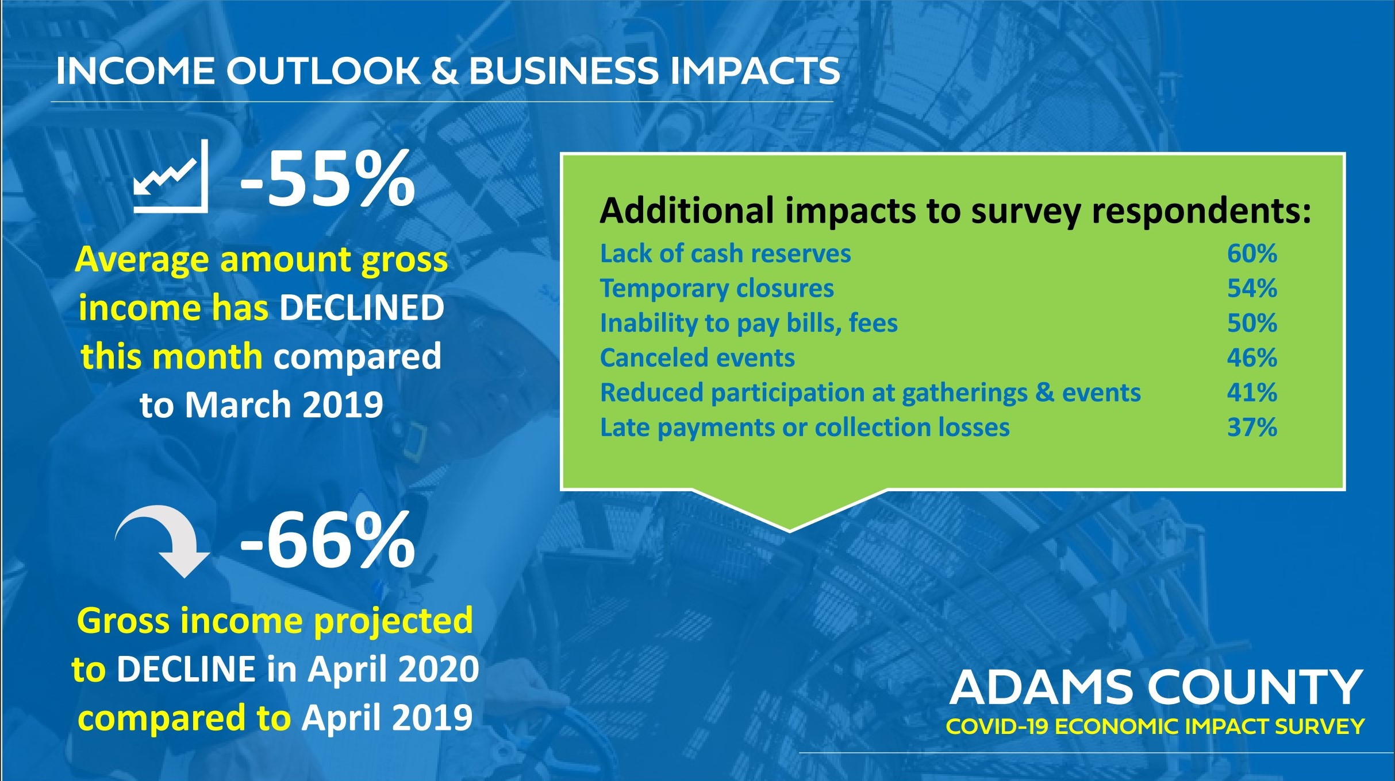
Adams County COVID-19 Economic Impact Survey Update
Bo Martinez, President/CEO, Adams County Economic Development
Notes:
Becky

Slide 6
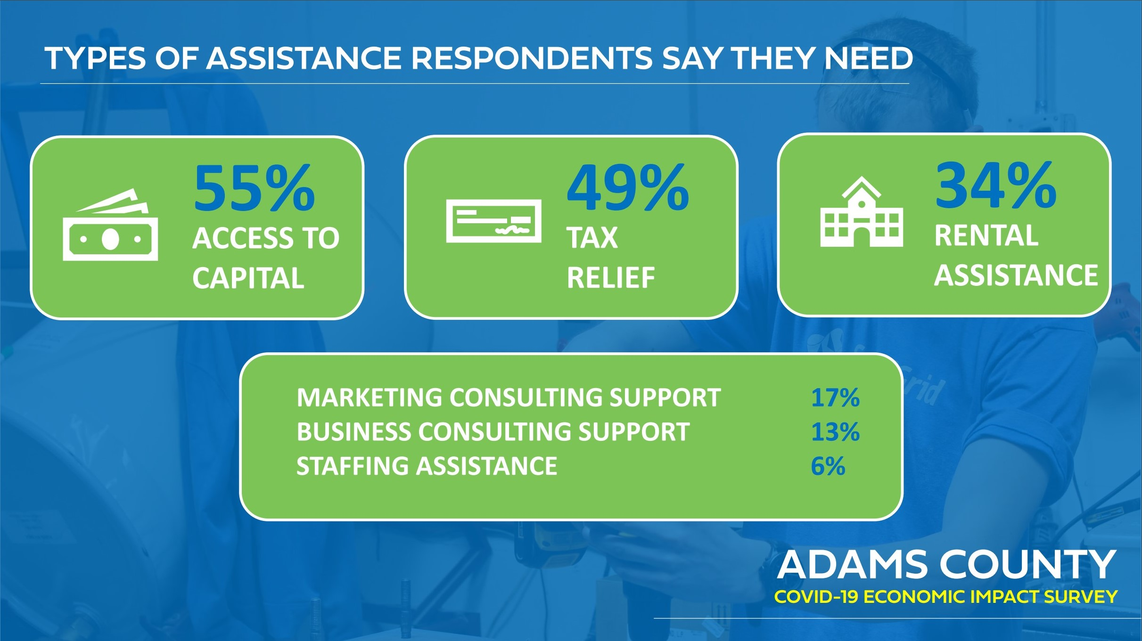
Adams County COVID-19 Economic Impact Survey Update
Bo Martinez, President/CEO, Adams County Economic Development
Notes:
Becky

Slide 7
Adams County Response
As part of its COVID-19 emergency management and recovery strategy, Adams County Government, through the County Manager’s Office, has identified key areas where there is an opportunity to ensure its resources and support are strengthened and effectively and efficiently aligned for residents and businesses. To better understand emerging needs, provide information and aid in real-time, including policy and system shifts that may be needed, the following Response and Recovery Teams have been developed:
Childcare for Critical Personnel
Small Business Support
Senior Services
Support for the Uninsured
Housing Stability
Food Security and Basic Essentials
Support for the Unemployed and Future Workforce
Adams County has enlisted the support of the Rocky Mountain Cradle to Career Partnership's staff, referred to as the Backbone, to provide behind the scenes support for these five strategic projects.

Slide 8
Uninsured and Healthcare
Strategies
Promote the extended Emergency Open Enrollment Period for health insurance through Connect for Health Colorado.
Deploy mobile COVID testing for vulnerable residents including undocumented residents, and residents experiencing homelessness.
Big Wins
County Commissioners submitted a letter to the Governor to extend the open enrollment period, which was adopted - the period was extended from April 3 to April 30.

Slide 9
Child Care for Essential Personnel
Strategies
Ensure essential personnel and their employers are aware of and accessing child care support via the Colorado Emergency Child Care Collaborative
Lift barriers/needs frontline personnel are experiencing related to child care provided through the Colorado Emergency Child Care Collaborative and work with the Collaborative to improve the system.
Work with Xfinity to support educators and students who are having trouble accessing internet through currently available programs in order to support virtual learning.
Lift the needs that child care providers are identifying in real time for PPE, supplies, and resources to entities facilitating the collection and distribution of these resource and supplies.
Prepare for Phases 2 and 3 of the Colorado Emergency Child Care Collaborative (Reopening closed facilities, opening new sites)
Big Wins
State has expedited matching process for families and providers with launch of an app.
Centura Health now has access to up to date information to provide healthcare workers about what is needed to apply for and how to access free childcare.
ECPAC is now connecting essential personnel willing/able to pay for childcare with providers outside of state program.

Slide 10
Business Support Response and Recovery Team
Taskforce Objective: This strategic effort is focused on supporting business retention and the county’s economy during this unprecedented health crisis.
Work with business owners to understand challenges facing operations due to COVID19 impacts or related Government orders.
Use guidance from business to help draft effective and useful County policy to support the local economy.
Bring together all relevant stakeholders with the County (Government, Municipalities, EDs, Chambers, and Business Community) to ensure coordinated response and recovery effort.
Notes:
Becky

Slide 11
Business Support Taskforce
ADCO Business and Industry Emergency Response Council
Business Outreach
Financial, Insurance, and Real Estate
The ADCO Business and Industry Emergency Response Council: gain an understanding of the challenges facing Adams County industries, businesses and employees to identify potential policy and program solutions to assist in immediate response efforts and eventual recovery.
Business Outreach: relay information about critical services and programs available to businesses, including Spanish-speaking, women, and minority-owned businesses, across multiple platforms.
Financial, Insurance, and Real Estate: engage industry leaders to provide information on issues impacting the financial, insurance, and real estate industries from COVID-19. Identify the extent of the economic impacts, suggest strategies, policies and ways to speed post recovery at the local level and support requests for state and federal emergency funding.
Notes:
Becky

Slide 12
ADCO Business & Industry Emergency Response Council
Nicole Milo- Centura Health
Preston Gibson- Xcel Energy
Tom Stone- Adolfson & Peterson
Jeff Elkin- True Style Doors
Jim Hayes- Oakwood Homes
Bill Unrein- Vectra Bank
Bryant Robbins- United Power
Tom Clark- Collaborative Economic Development
Kittie Hook- Newmark Knight
Chris Howes- CO Retail Council
Lauren Lambert- Google
Lisa Hough- Metro Denver EDC
Troy Whitmore- United Power
Amie Mayhew- Colorado Hotel & Lodging Association
Shaun Egan- Iron Woman Construction
Adrian Gutierrez- 3 Margaritas
Jon Lehmann- Comcast
Troy Hill- Hill Petroleum
Carolynne White- Brownstein Hyatt Farber Schreck
Jason Barrow- Boyers Coffee
Gary Arnold- Pipefitters Local Union
Susan Fakharzadeh- Great Western Petroleum
Vicky Lea- Metro Denver EDC
Shannon Robbins- Brookfield Properties Development

Slide 13
Business Needs and Response
Access to PPE and critical supplies
Support with understanding loan and grant processes (local and federal)
Support for understanding best practices for businesses to stay afloat retain staff
Inspections and permitting process was slow at the beginning of the crisis
Suspension or deferral of taxes
Lack of availability of information and resources in Spanish
Clarity around the Stay at Home order and business exemptions

Slide 14
Adams County Stimulus Package- Total $7 Million Fund
COVID-19 Response Community Small Business Loan Fund Goal: $5M Fund
Small Business COVID-19 Grant Program Goal: $1M Fund
Community Emergency Response Fund: $1M Fund
Adco To-Go Restaurant Campaign
Community wide campaign that will highlight the robust restaurant offerings that have been pulled together by various communities across the County and support restaurant retention
Notes:
Becky

Slide 15
Support for the Unemployed and Future Workforce Response and Recovery Team
The Support for the Unemployed and Future Workforce Response and Recovery Team is focused on supporting residents experiencing unemployment during the COVID-19 Crisis, and considering what the future economy will look like during recovery.
The Team is currently gathering data and insight in order to identify gaps and barriers that exist, specifically focusing on:
Which industries are most affected now, and projected to be affected?
What percentage of those without work were independent contractors?
What local/state/federal resources are available to support those without work?
What industries are currently thriving, and NEED workers?
What industries will be thriving in the future

